Slide 1








Microsoft
Azure
Data
Engineering
project

Slide 2




Team members
Microsoft
Azure
Data
Engineering
project
Olena
Akisheva
Mehmet
Arif
yazikoz
Gokmen
salbas
Sefa
sahan

Slide 3
Project Aim
Microsoft
Azure
Data
Engineering
project
Efficient Data Handling
Data Quality Assurance
Data Harmonization
Automated Data Pipeline
PowerBI Reports
Notes:
"Hello everyone, my name is [Name] and we are here to present our project. We're using machine learning techniques to predict credit scores for bank customers, by using their historical financial information. By doing so, we aim to provide a solution that will enable banks to make more informed lending decisions, while accurately measuring credit risk. Our goal is to build a credit score prediction model with bank customer data, which will ultimately help banks assess the creditworthiness of their customers with greater accuracy."

Slide 4
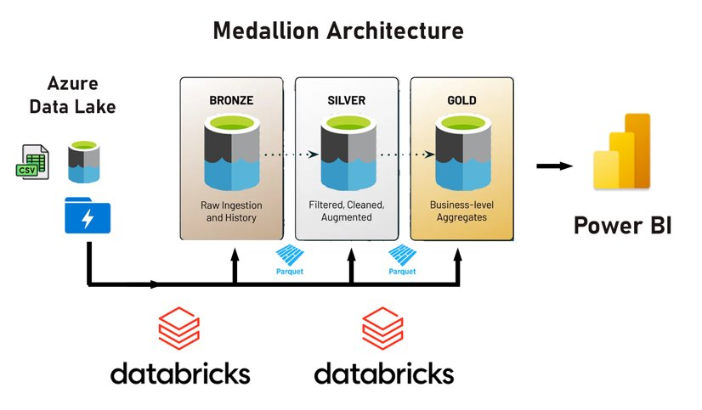
Data Architecture
Microsoft
Azure
Data
Engineering
project
Notes:
As you can see in the chart, we have some missing values, as well as outliers, in our dataset. Additionally, we found that some columns had redundant information, such as 'Monthly Salary' and 'Annual Salary', which required us to perform further data cleaning."

Slide 5

WHY DATABRICKS?
Unified Platform
Apache Spark Integration
Scalability
Managed Services
Collaboration and Productivity
Microsoft
Azure
Data
Engineering
project
Notes:
As you can see in the chart, we have some missing values, as well as outliers, in our dataset. Additionally, we found that some columns had redundant information, such as 'Monthly Salary' and 'Annual Salary', which required us to perform further data cleaning."

Slide 6
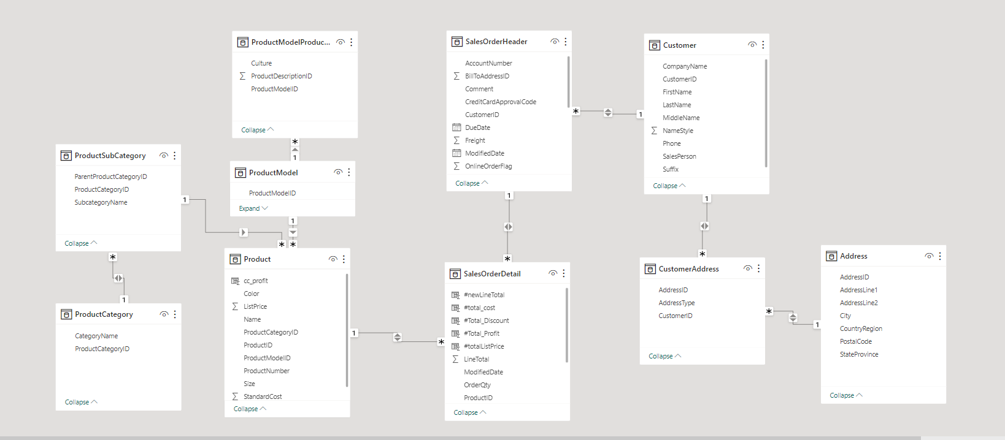
Medallion process
Microsoft
Azure
Data
Engineering
project
Data Ingestion: Fetch data from Azure Storage (CSV).
Data Lake Gen2: Organized folder structure
Data Transformation: Modify data types,, remove irrelevant columns (
Data Storage: Load transformed data into Parquet files (
Data Schema Transformation: Shift from snowflake to star schema through table joins (Silver layer).
Data Aggregation: Correct line total and list price issues; aggregate total cost and total profit.

Slide 7
Reports
Microsoft
Azure
Data
Engineering
project

Slide 8
Reports
Microsoft
Azure
Data
Engineering
project

Slide 9
Reports
Microsoft
Azure
Data
Engineering
project

Slide 10
Reports
Microsoft
Azure
Data
Engineering
project

Slide 11

teamwork
Microsoft
Azure
Data
Engineering
project

Slide 12
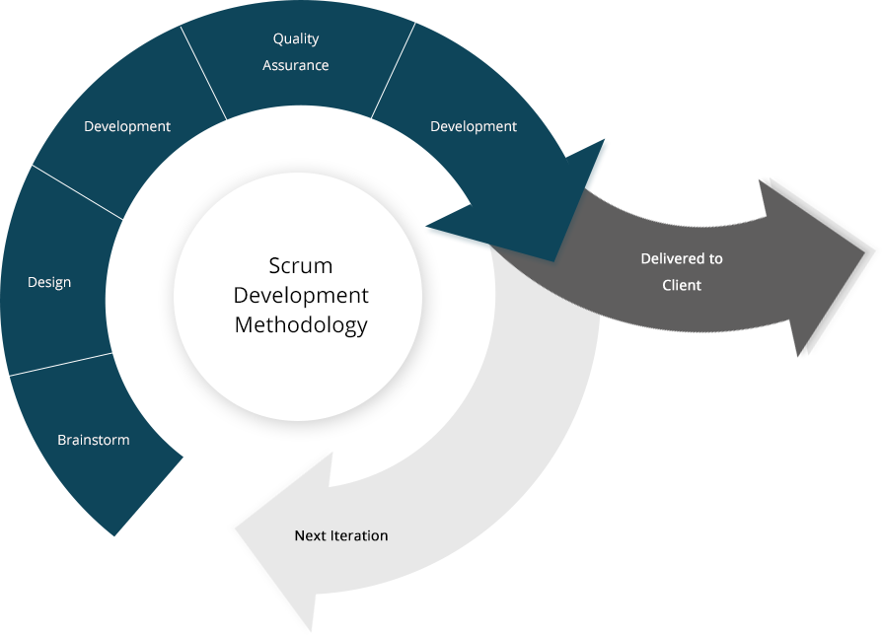

teamwork
Microsoft
Azure
Data
Engineering
project

Slide 13








results
PYTHON
SQL
dATABRICKS
data factory
Synapse Analytics
storage accounts
power bi
Microsoft
Azure
Data
Engineering
project

Slide 14





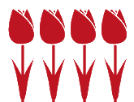


results
Appointments
Microsoft
Azure
Data
Engineering
project
Time Perception
NETHERLANDS
Decisions Group
Dress code
Hierarchy Flat

Slide 15
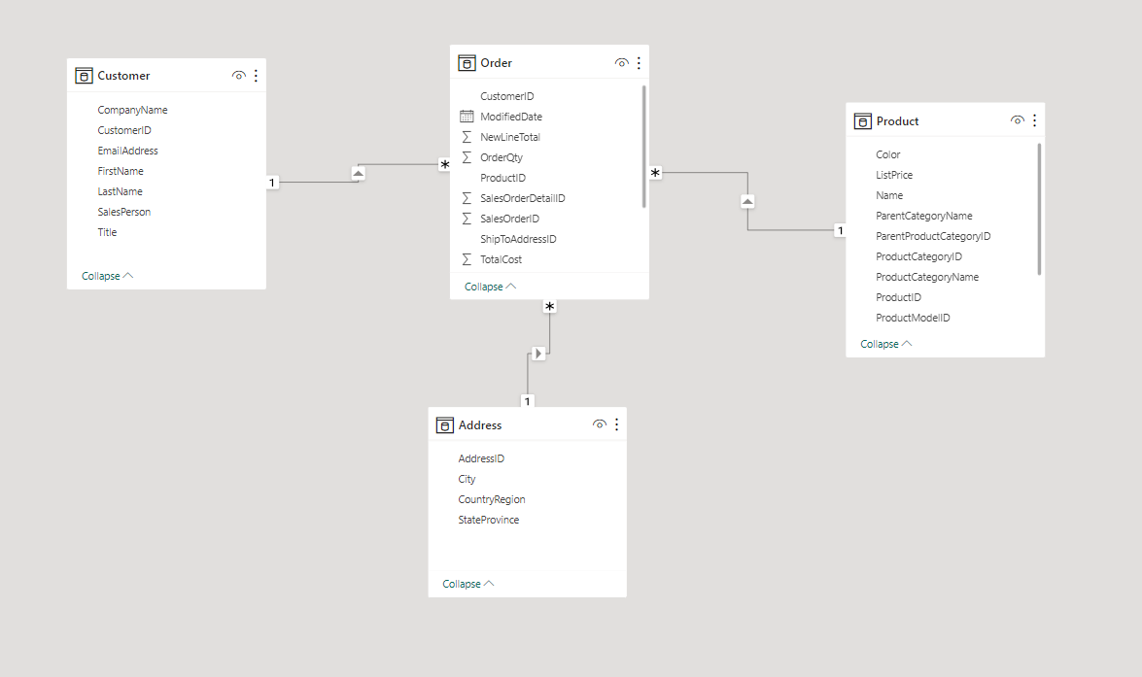

Snowflake – star schema
Microsoft
Azure
Data
Engineering
project

